Slide 1
Image-Based Deep Learning & Reinforcement Learning Strategy Design
Team 6 Members
Pamela Alvarado-Zarate
Mark Hite
Harshal Kamble
Vishnu Sankhyan
Venkatesh Subramony
April 28, 2025
Notes:
Thao

Slide 2





Agenda:
Dataset Introduction
Image Generation
Object Detection
Image Captioning
Reinforcement Learning Strategy Design
Notes:
Charanya

Slide 3
Datasets

Slide 4
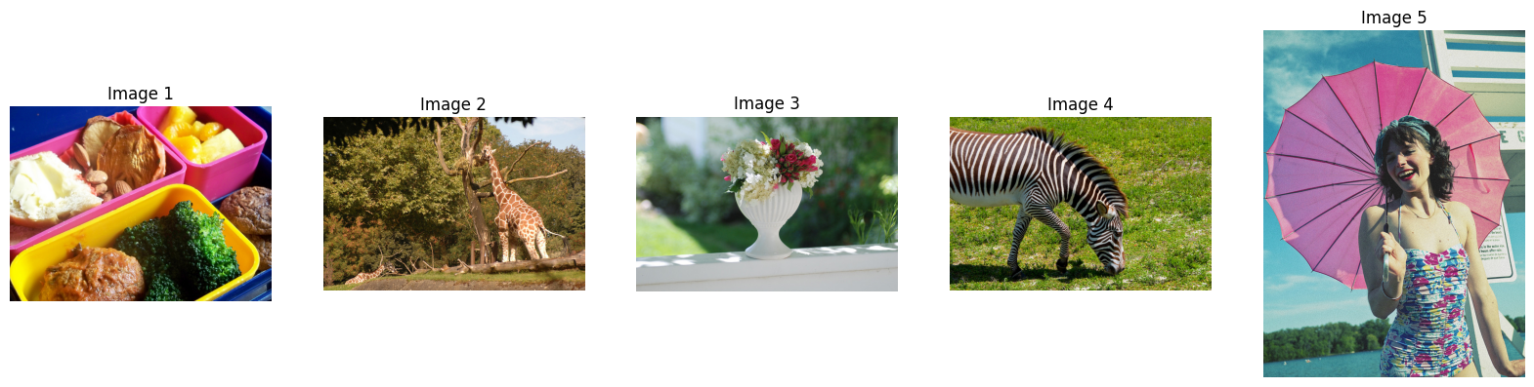
Image Generation Dataset – COCO
COCO (Common Objects in Context)
train2017 – 118,287 images
Contains entities belonging to 80 different classes (person, chair, car, etc.)
Sample images from COCO train2017

Slide 5
Image Generation Using GAN

Slide 6

Methodology & Model Architecture
Discriminator Loss
COCO Dataset
Preprocessing:
Resize to 64x64
Convert to PyTorch tensor
Normalize values [-1,1]
Real Image
Backpropagation
Update weights
(3,64,64)
Discriminator
Random Noise
Generator
Fake Image
[0,1] probability
5 convolutional layers
Output layer: Sigmoid
(100,1,1)
(3,64,64)
5 convolutional layers
Output layer: Tanh
Generator Loss
Backpropagation
Update weights

Slide 7
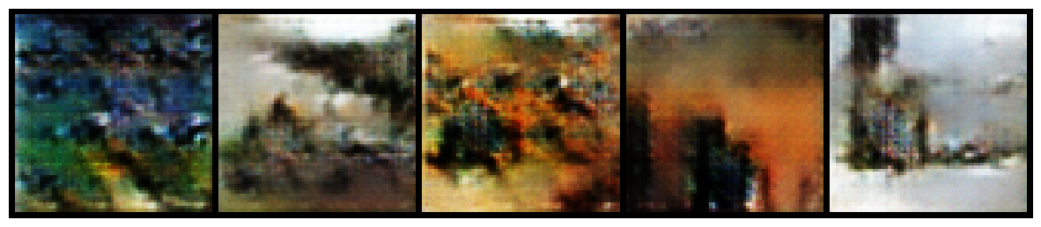
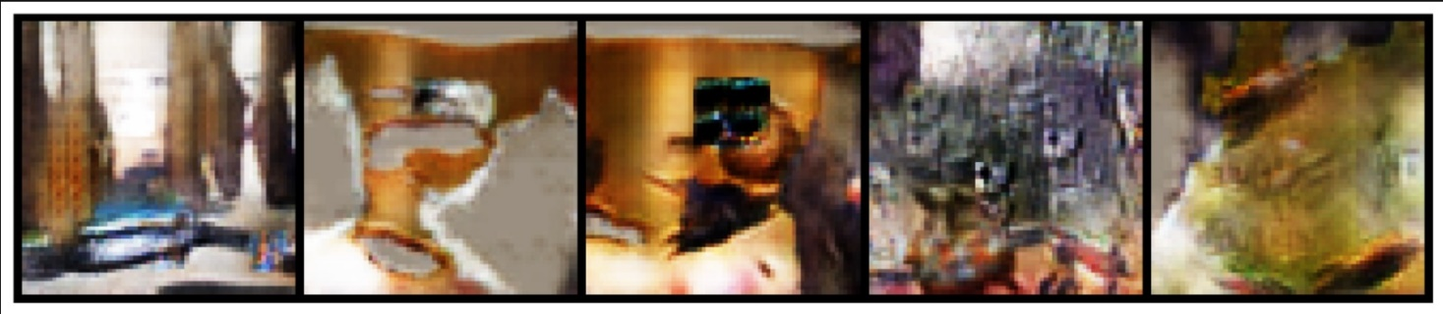
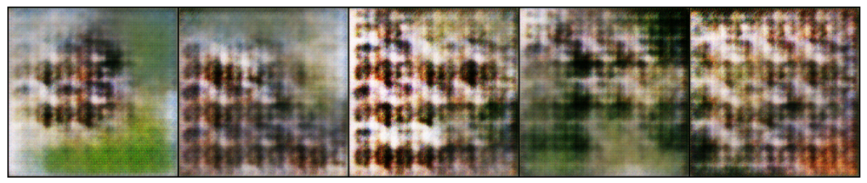
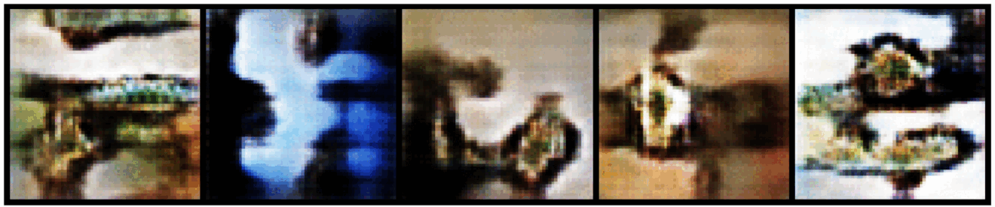
Training Images | Epochs | Resolution | Final Iteration
10,000 | 20 | 64x64
20,000 | 100 | 64x64
1,000 | 50 | 256x256
Training & Results
Optimizer: Adam
Learning rate: 0.0002
Loss function: Binary Cross-Entropy
Training images: 100,000
Epochs: 20
Image size: 64x64
Alternative tests with worse performance
5 images over 20 epochs

Slide 8
Object Detection

Slide 9
Detect objects in 5 collected images using YOLOv5s.
🔹 Methodology:
Uploaded 5 custom images (Dog, Bird, Car Showroom, Street Car, Lemur)
Used YOLOv5s pre-trained model for direct inference
Set confidence threshold at 0.25 to filter weak predictions
Applied Non-Maximum Suppression (NMS) to remove duplicate boxes
Visualized outputs with bounding boxes and class labels
🔹 Model Architecture (YOLOv5s):
Backbone: CSPNet (feature extraction)
Neck: PANet/FPN (multi-scale feature fusion)
Head: YOLO Detection Head (bounding box + class prediction)
Output: Bounding boxes + class labels + confidence scores
Methodology | Model Architecture
Upload images | CSP Net Backbone
Run YOLOv5s inference | PANet/FPN Neck
Filter by confidence >0.25 | YOLO Detection Head
Apply NMS | Bounding Box + Class Output
Notes:
I uploaded 5 images from the dataset and used YOLOv5s, a lightweight model pre-trained on the COCO dataset.
0.25 confidence threshold and applied Non-Maximum Suppression to clean the outputs.
major objects detected dogs, birds, cars, and people
YOLOv5s is faster, lighter, and enough for small-scale tasks.
NMS removes duplicate/overlapping bounding boxes and keeps only the best one
0.25 confidence to balance between detecting more objects and reducing false positives.

Slide 10
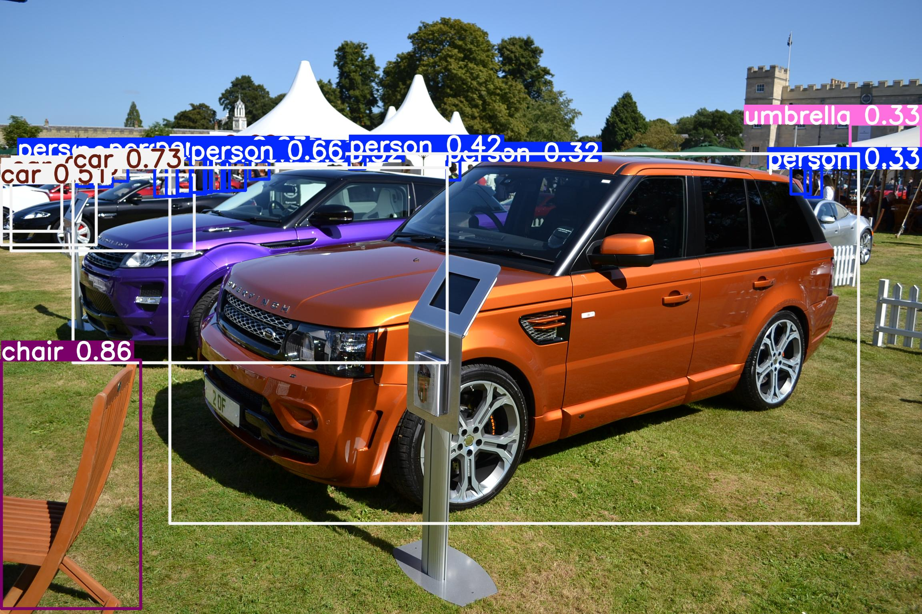
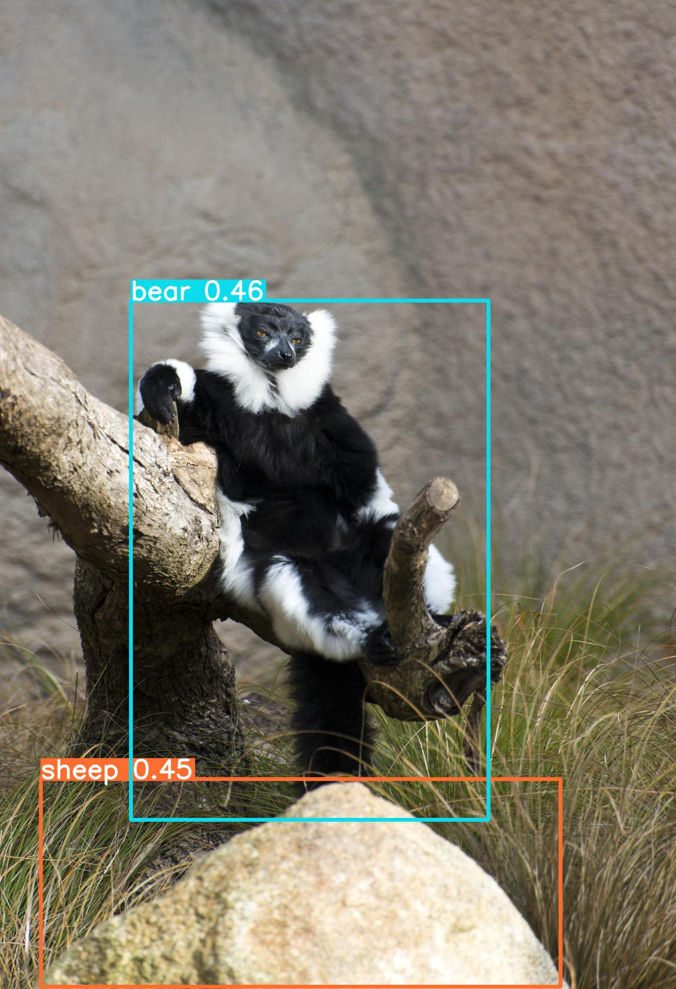
Detection Results
Image | Detected Objects | Notes
Dog | Dog (0.53) | Correct
Bird | Bird (0.87) | Correct
Car Showroom | Car, Chair, Person, Umbrella | Correct
Urban Street | Car, Stop Sign, Person | Correct
Lemur | Bear, Sheep | Misclassified
Observations and Conclusion
Observations:
High accuracy for common objects (dogs, cars, birds)
Some low confidence detections (<0.5) for small persons
Misclassification for rare objects (lemur)
Conclusion:
YOLOv5s was effective without fine-tuning.
Suitable for fast object detection tasks.
Future work: Custom training for rare categories.
Notes:
Misclassification of Lemur as Bear/Sheep.
Some low-confidence detections in busy scenes.
YOLOv5s is faster, lighter, and enough for small-scale tasks like 5-image detection.
NMS removes duplicate/overlapping bounding boxes and keeps only the best one
0.25 confidence to balance between detecting more objects and reducing false positives.

Slide 11
Image Captioning

Slide 12




Libraries
Saving word-to-index mappings, configuration and other internal states after fitting the text tokenizer onto captions.
Disk & reload fitted tokenizer
Store and manipulate image feature arrays, token sequences, and batch data.
Efficiently pad, slice, and reshape data for model input.
Access to Keras API
machine learning fundamentals
Utility to truncate lists of integer sequences to a uniform length.
Complex and advanced ML architecture
neural networks (CNNs & RNNs)
Notes:
pickle provides a straightforward mechanism to dump the fitted tokenizer to a file and load it back for inference or continued training.

Slide 13



Text Processing
≤ 34 Tokens (MAX_LENGTH)
5k Common Words (VOCAB_SIZE)
Special Tokens
<start>, <end>, <unk>
Notes:
Keras Tokenizer
Caption is restricted to 34 tokens and a vocabulary consisted the 5,000 most common words in the english language
with special <start>, <end>, and <unk> tokens for caption to being after <start> and end with <end>

Slide 14
Encoder-Decoder Paradigm
JPEG Image File
CNN
(ResNet50 pretrained on ImageNet)
3D Feature Map (7x7x2048)
Global Average Pooling
2048-Dimensional Feature Vector​
Expand & Tile
shape [seq_len×2048]
drop final classification layers
mean subtraction & scaling
NumPy Array =
(height, width, channels) = (224, 224, 3)
Features
Embeddings
masking padding tokens
224x224
pixels
Inference Loop
Map ID - > Word
Append to caption list
If no <end>, loop back with new word embedding
Join list - > final caption
Dense (VOCAB_SIZE)
Dense
LSTM
output =
[batch, seq_len, 512]
Logits
Notes:
pickle provides a straightforward mechanism to dump the fitted tokenizer to a file and load it back for inference or continued training.

Slide 15
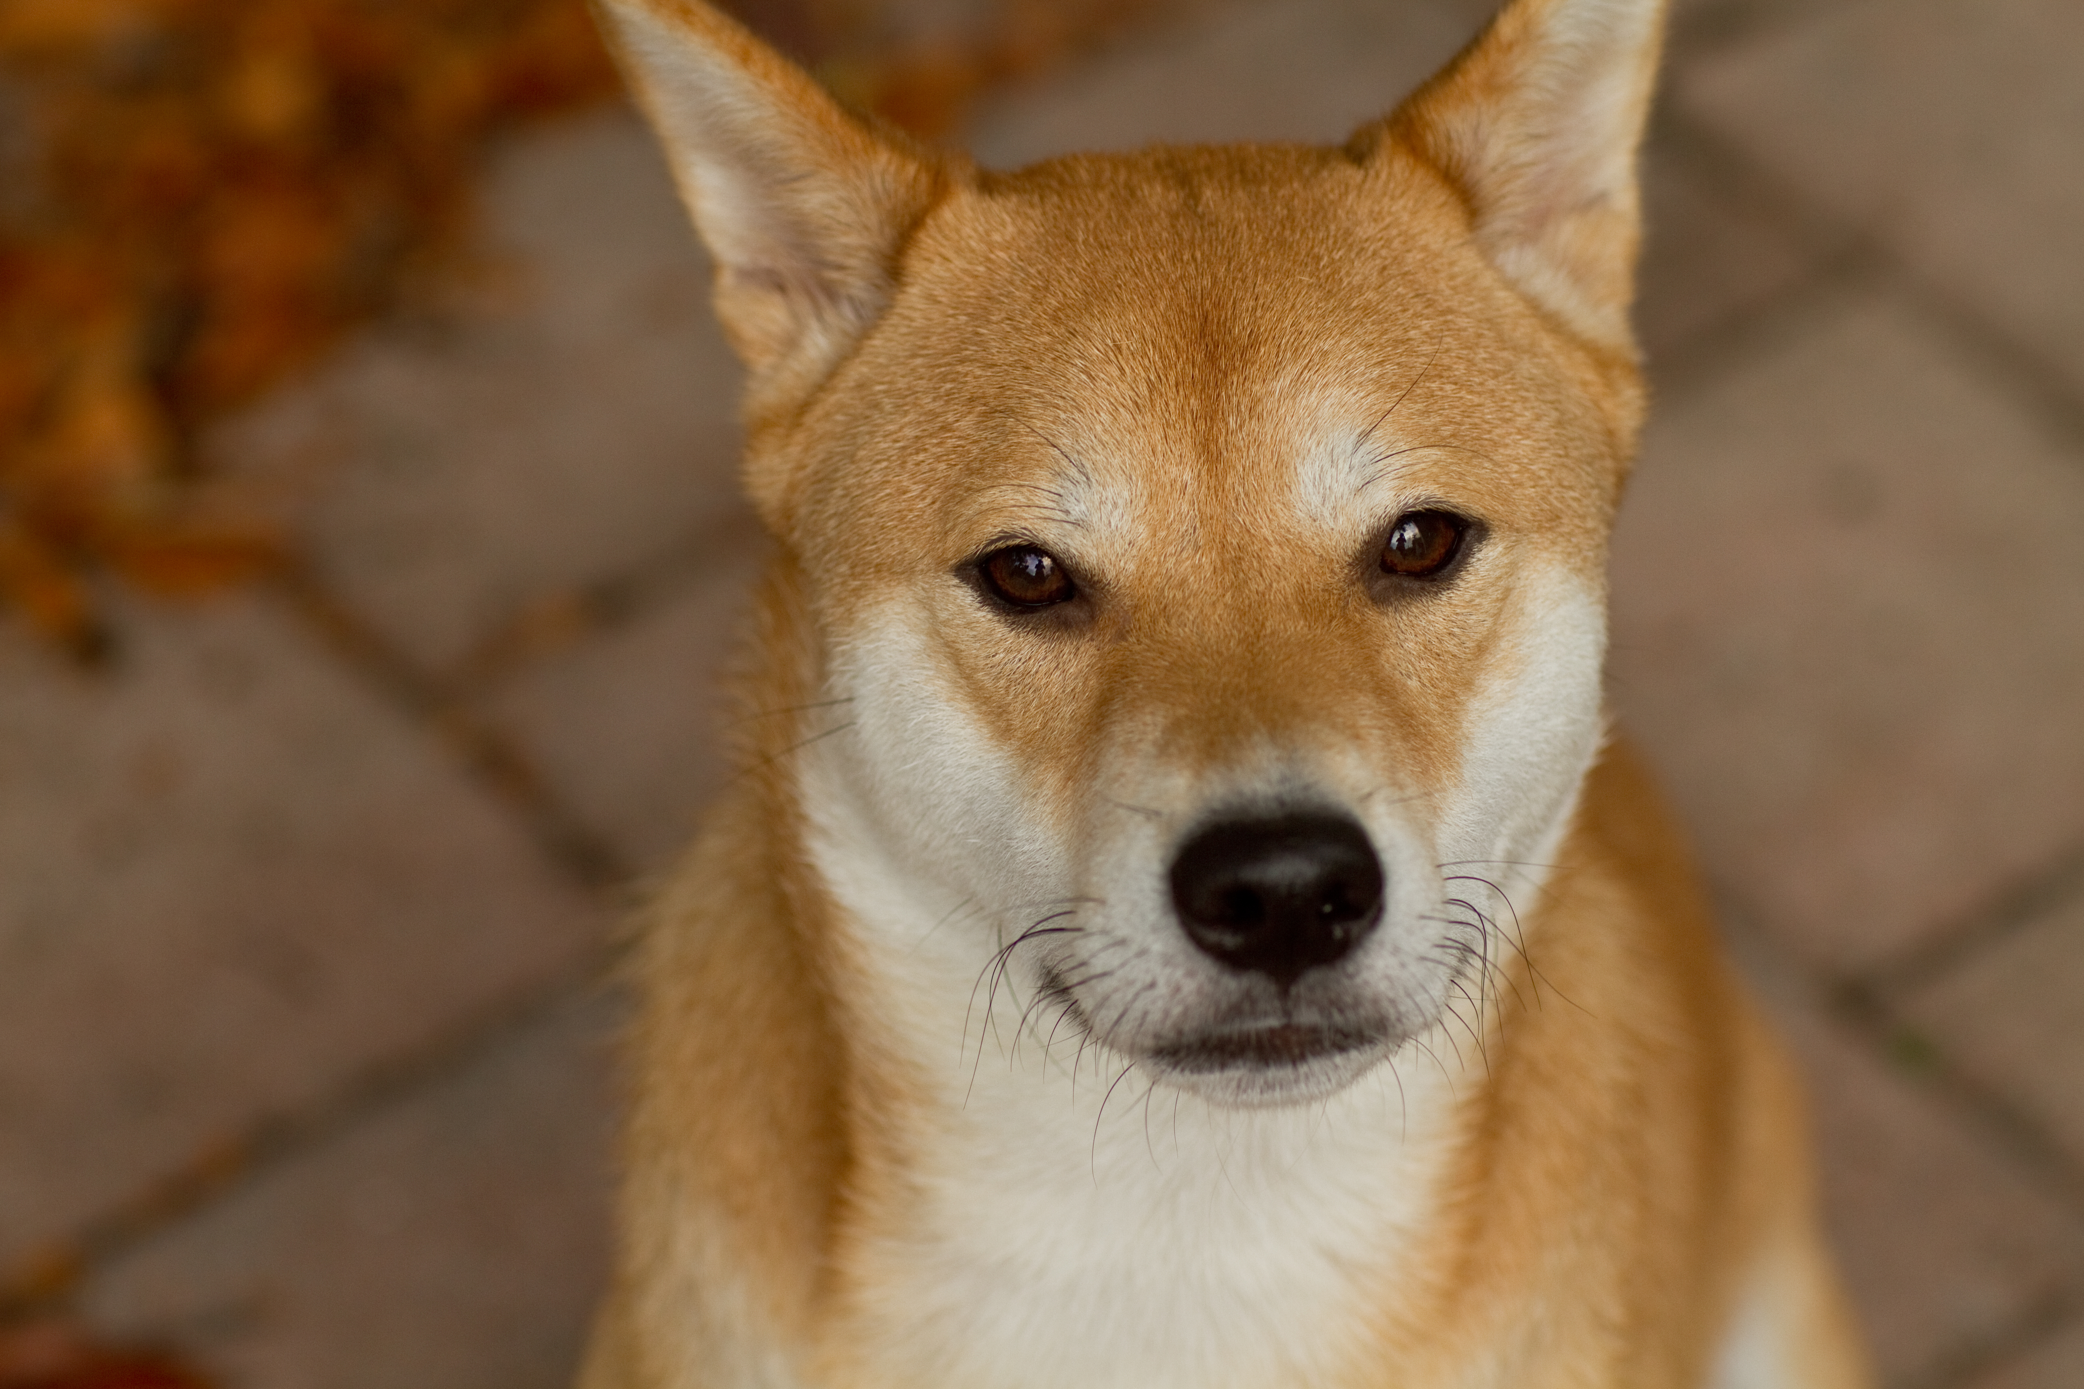
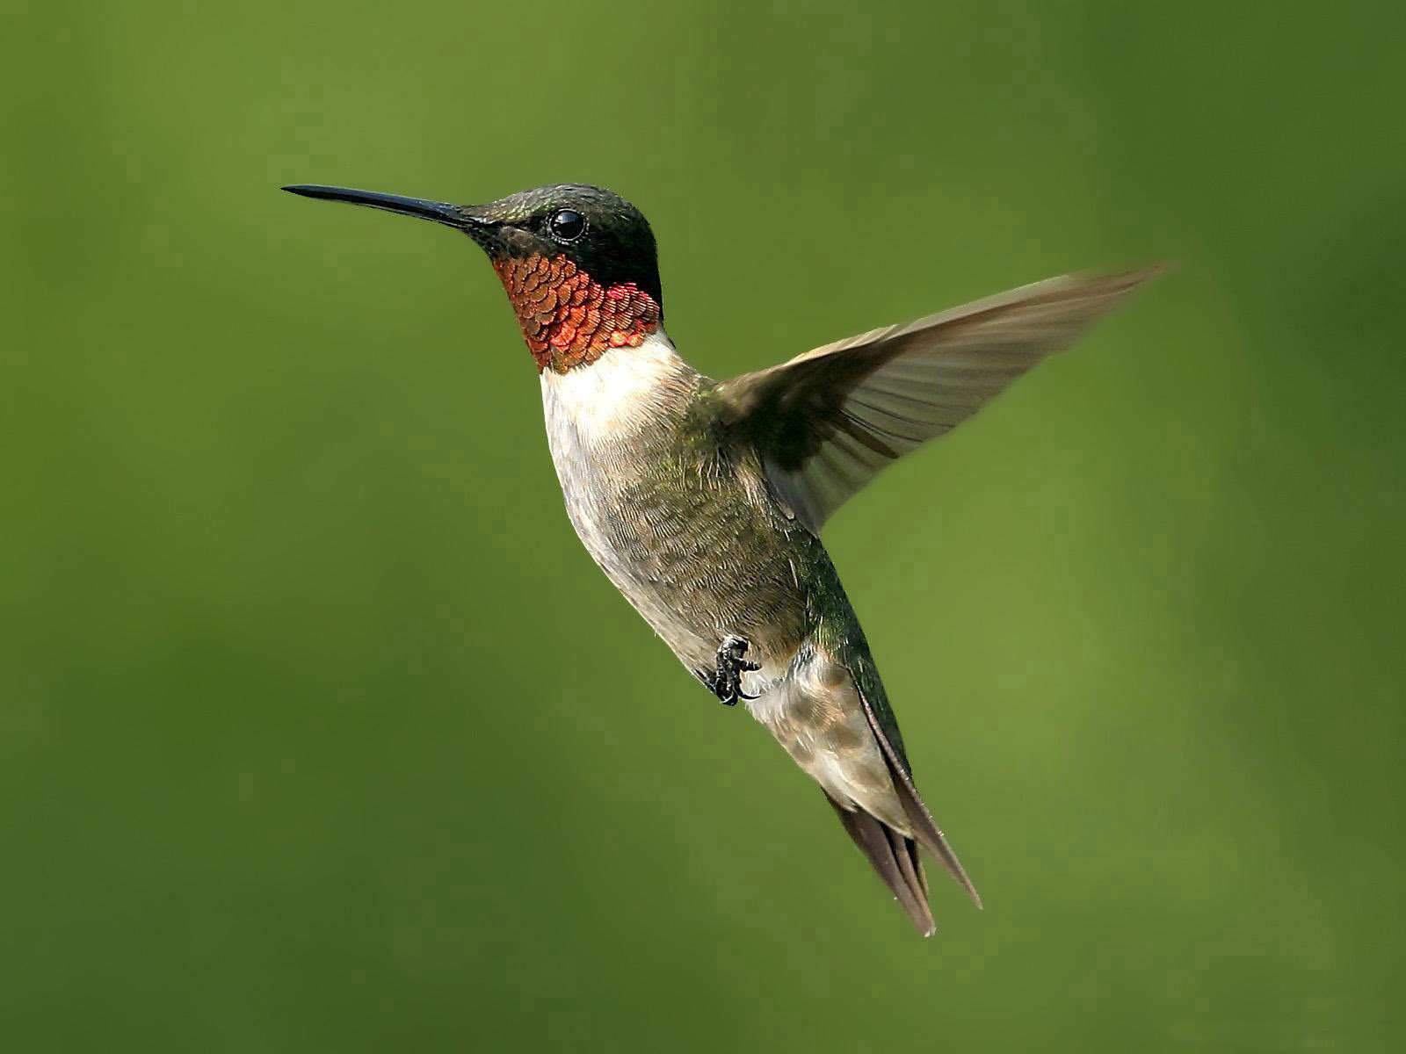
Generated Caption: a male wings hummingbird hovering hummingbird hovering hummingbird hovering hummingbird hovering hummingbird...[continues]
Ground-Truth
<start> a ruby-throated hummingbird hovering in front of a green background <end>
<start> a small hummingbird with iridescent red throat and outstretched wings mid-flight <end>
<start> a tiny bird with long beak flapping its wings in midair <end>
<start> a close-up of a hovering hummingbird showing blurred wings <end>
<start> a male hummingbird suspended in flight against a soft green backdrop <end>
Generated Caption: a close dog dog dog dog dog dog dog dog dog dog dog dog dog dog dog dog dog dog dog dog dog dog dog dog dog dog dog dog dog dog dog dog
Ground-Truth
<start> a close-up portrait of a tan and white dog with perked ears looking at the camera <end>
<start> a fox-like dog sitting on a stone patio gazing forward <end>
<start> a golden canine with erect ears and a black nose on paving stones <end>
<start> a shiba inu style dog with warm russet fur staring at the lens <end>
<start> a medium-sized dog with white chest and alert expression on tiled ground <end>

Slide 16
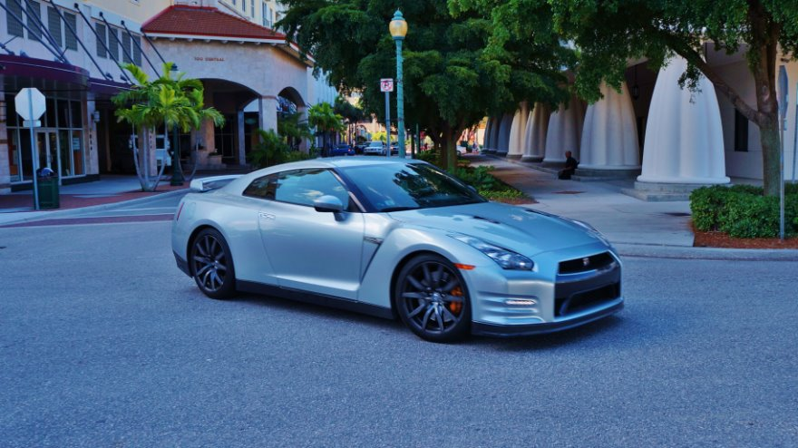
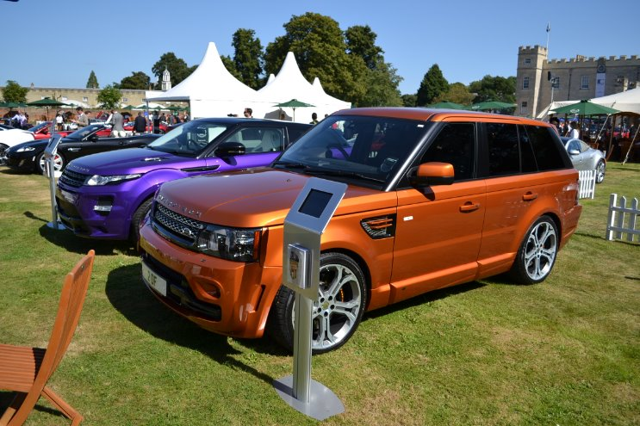
Generated Caption: a manicured orange orange orange orange orange orange orange orange orange orange orange orange orange...[continues]
Ground-Truth
<start> an orange Range Rover Evoque parked on grass at a car show <end>
<start> a vivid orange SUV displayed beside a purple crossover under white tents <end>
<start> two sporty SUVs, one orange and one purple, lined up on a manicured lawn <end>
<start> a bright orange luxury crossover with polished wheels on the grass <end>
<start> an orange Range Rover model exhibited outdoors with onlookers <end>
Generated Caption: a city silver r silver silver silver silver silver silver silver silver silver silver silver silver silver silver silver silver silver silver silver silver silver silver silver silver silver silver silver silver silver silver
Ground-Truth
<start>a sleek silver Nissan GT-R parked on a city street in front of columns<end>
<start>a metallic silver sports car with black wheels parked on asphalt<end>
<start>a high-performance coupe under leafy trees on a downtown road<end>
<start>a low-slung silver GT-R near white arched architecture<end>
<start>a luxury performance vehicle parked by a plaza with pillars<end>

Slide 17
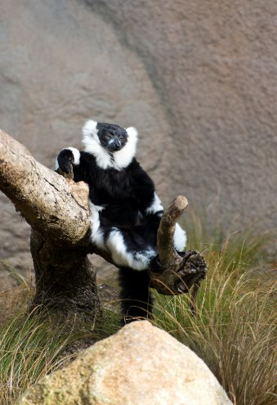
Generated Caption: a fluffy lemur end end end end end end end end end end end end end end end end end end end end end end end end end end end end end end end
Ground-Truth
<start> a black-and-white ruffed lemur sitting on a tree branch with a fluffy collar <end>
<start> a lemur with tufted ears lounging against a log in its enclosure <end>
<start> a primate with monochrome fur perched on a branch looking away <end>
<start> a relaxed black-and-white lemur draped over a wooden limb <end> 5)
<start> a fluffy-collared lemur casually resting on a tree branch <end>

Slide 18
Reinforcement Learning Strategy Design

Slide 19
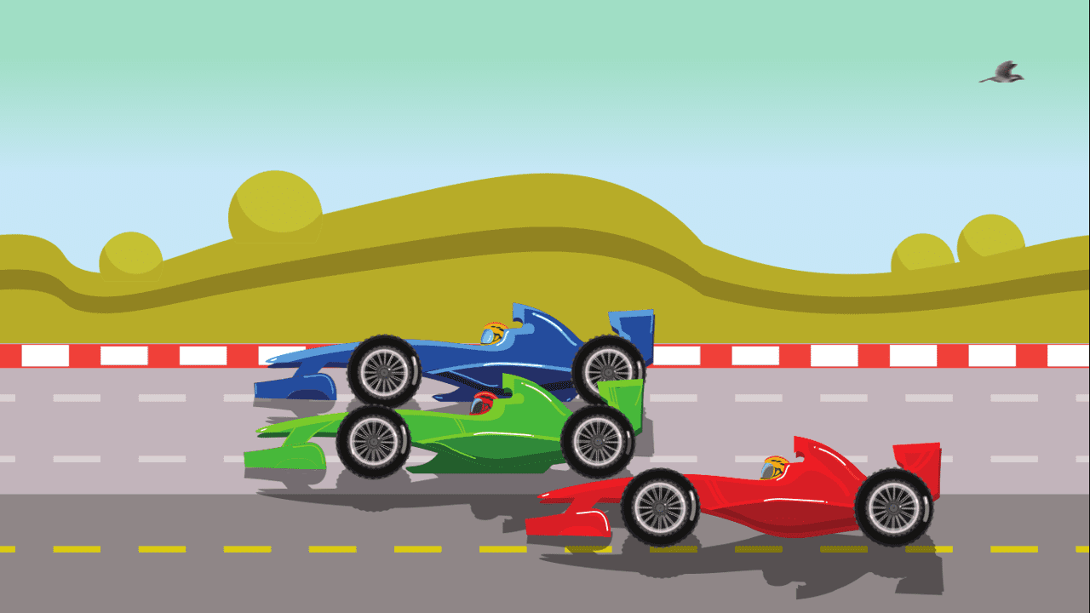
Reinforcement Learning Strategy Design​
Designing an optimal strategy for a computer (AI) to play a video game using Reinforcement Learning.
Game: 2D StreetRacer

Slide 20
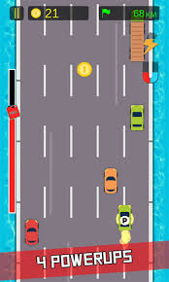
The Game: 2D Street Racer
Game Description
The game is a top-down endless racing game where a player-controlled car navigates through traffic, collects coins, and avoids collisions with other cars.
Why This Game?
2D Street Racer is a simple game, but with a dynamic environment for reinforcement learning:
Continuous state updates (car and traffic positions)
Clear success/failure metrics (coins collected vs. collisions)
Real-time decision-making similar to real-world driving/robotics problems
The game’s mechanics make it ideal for testing RL methods.

Slide 21
States, Actions and Rewards
States (S)
Actions (A)
Rewards and Penalties (R and P)
Position of the player car on the road (x-axis lane)
Relative positions of other cars and obstacles
Current speed
Distance traveled (progress)
Coin collection status
Fuel/power level
Move left
Move right
Accelerate
Decelerate
Do nothing
Rewards (R):
+1 for each coin collected
+5 for a set distance milestone (e.g., every 100m)
-10 for hitting another car (collision)
-5 for going out of bounds
Penalties (P):
Collisions reset the episode or end the game
Going out of bounds incurs a penalty and episode ends
Why This Reward Strategy?
Coin collection provides frequent small rewards (+1) → encourages exploration.
Milestone rewards (+5 every 100m) promote survival over time.
Collision penalty (-10) provides strong discouragement from poor driving.
Using discounted future rewards balances short-term gains (e.g., coin) with long-term survival (distance milestones).
This strategy ensures that the agent doesn't just greedily go for coins but learns to drive safely to last longer.

Slide 22
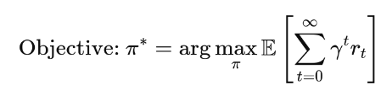
Performance Measure
In this game, we aim to maximize the expected discounted sum of future rewards.
Formally:
r_{t}​: reward at time step t
γ: discount factor (typically between 0.9 and 0.99)
π: policy (the agent’s behavior)
Here, the agent:
Balances the value of immediate rewards (like coins right now) and the potential future rewards (like surviving longer).
Prefers long-term gains even if it means skipping a risky immediate reward.

Slide 23
Step-by-Step Simulation
Step | State (St) | Action (At) | Reward (Rt+1) | Next State (St+1) | Notes
0 | Center lane, no traffic nearby, speed = 1 | Accelerate | 0 | Speed increases to 2, moved slightly forward | Start moving faster
1 | Center lane, speed = 2, coin visible ahead | Move left | 0 | Now in left lane, closer to coin | Moving to align with coin
2 | Left lane, coin 1 step ahead | Do nothing | +1 | Collected coin, increased reward | Successful coin collection
3 | Left lane, approaching slow car ahead | Move right | 0 | Center lane, avoided slow car | Avoiding collision
4 | Center lane, moderate speed, distance = 100m | Do nothing | +5 | Speed maintained, milestone reached | Reward for survival
5 | Center lane, traffic denser | Decelerate | 0 | Speed decreases to 1 | Safer in dense traffic
6 | Center lane, fast car behind approaching | Move left | 0 | Back to left lane | Avoiding being hit
7 | Left lane, no obstacles | Accelerate | 0 | Speed increases to 2 | Moving forward safely
8 | Left lane, obstacle appears suddenly | No Action (Agent delays) | -10 | Collision, episode ends | Crashed into obstacle

Slide 24
Exploration vs. Exploitation in RL
Concept:
Exploration: Trying random actions to discover new strategies or better paths.
Exploitation: Using the best-known action according to the current learned policy.
Implementation: Use ε-greedy policy:
With probability ε, take a random action (exploration). With probability 1 - ε, take the best-known action (exploitation).
Typical Strategy:
Start with ε = 1.0 → Full exploration.
Gradually decay ε after each episode:
Example: ε = ε × decay_rate, e.g., 0.995
Final ε floor like 0.1 or 0.05 to keep occasional exploration alive.

Slide 25
Neural Network Structure
The Model
Input Layer:
Vectorized environment features (positions, speeds, coin locations) or a processed 2D visual snapshot of the road.
Hidden Layers:
Dense layer (64 neurons, ReLU activation)
Dense layer (64 neurons, ReLU activation)
Output Layer:
Linear layer with one neuron per action, outputting Q-values for each possible action.
Why We Chose This Model
A Deep Q-Network (DQN) effectively handles high-dimensional input spaces where simple tabular Q-learning would fail.
Fully connected layers are sufficient for structured state inputs, while CNN layers allow processing raw pixel data efficiently.
ReLU activations are chosen for faster convergence and to avoid vanishing gradients.
A linear output layer aligns with the Q-learning objective of estimating real-valued action-value functions.

Slide 26

Flowchart of the RL Process
ε-Greedy Action Selection
Execute the Selected Action
Initialize Environment &
Q-Network
Start Episode (Reset Game)
Observe the State (St)
Receive the States
(Rt+1, St+1)
Decay ε
Store the Transition
(St, At, Rt+1, St+1)
Episode Done
Train Q-Network
Sample Minibatch from the Stored Values
Example scenarios:
Collision with another car
Going out of bounds
Max. distance reached
Game in Progress
Termination Criteria:​ Training can stop once the agent consistently achieves a high average distance without frequent collisions.​

Slide 27
Evaluation and Improvement
Evaluation Metrics
Average Distance Traveled per Episode
Total Coins Collected per Episode
Number of Collisions (lower is better)
Average Cumulative Reward
Stability of Q-values over training epochs
Policy Improvement
Regularly evaluate performance and retrain if agent behavior stagnates.
Optionally, use a target network updated at fixed intervals to stabilize learning.

Slide 28
Thank you

